Slide 1
MOBILE NET

Slide 2
Table of Contents
01
02
03
04
Simple Definition
01
Key Features
01
Uses in Real-World
Softmax

Slide 3
In Simple Terms
MobileNet is a type of deep learning model designed specifically to run efficiently on mobile devices, tablets, and other devices with limited computing power. It is optimized to be lightweight, fast, and still provide high accuracy for tasks like recognizing images, objects, and patterns.
Think of MobileNet as a compact yet powerful model that makes it possible to use machine learning on devices like your phone without needing a supercomputer.

Slide 4
Benefits
Efficiency: It uses fewer resources (like memory and processing power), so it can run on mobile devices.
Speed: Fast predictions, even on devices without GPUs.
Accuracy: Performs well enough for real-world applications, even though it's lightweight.
How does MobileNet detect?

Slide 5
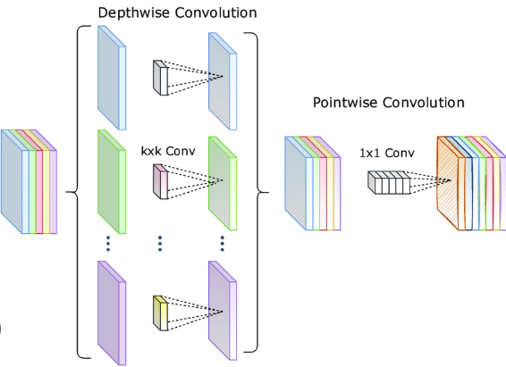
Depth-wise Separable Convolutions
MobileNet splits into two steps:
Depth-wise Convolution: Each channel (red, green, blue) is processed separately with its own filter.
Pointwise Convolution: A small 1×1 filter combines the outputs of these separate filters.

Slide 6

How it works
Instead of using a single filter for all channels, depth-wise convolution applies a separate filter for each channel (R, G, B). Each channel is processed independently.
This means you have:
One filter for the red channel. (3x 3 filter)
One filter for the green channel . (3x 3 filter)
One filter for the blue channel. (3x 3 filter)

Slide 7
Uses in Real-World

Slide 8
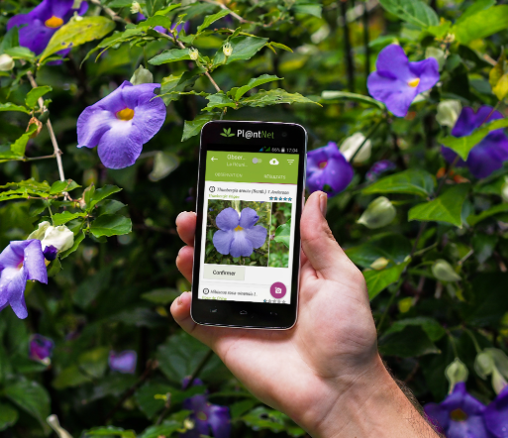
Image Recognition in a Mobile App
Imagine you’re using a gardening app that helps identify plants. You point your phone's camera at a flower, and the app tells you its name, care instructions, and even its watering schedule.
How Mobile Net Works Here:
The app uses a pre-trained MobileNet model to analyze the image on your phone.
It quickly identifies the plant by comparing it to thousands of known images.
Since MobileNet is efficient, this process happens in real-time without draining your phone’s battery or requiring an internet connection.

Slide 9
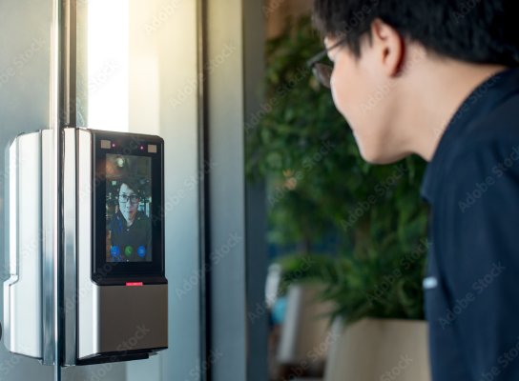
Face Detection
Smart locks often use face detection to grant access. When you walk up to your smart lock, it scans your face to decide if it should unlock the door.
.
The camera captures an image of your face and runs it through a MobileNet model.
The model processes key facial features and compares them to stored data of authorized users.
If it finds a match, the lock opens. If not, it stays locked.

Slide 10
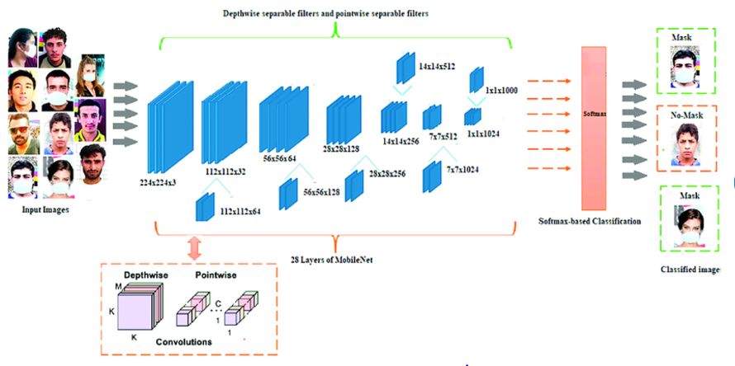


Slide 11
Filter Stride Padding

Slide 12
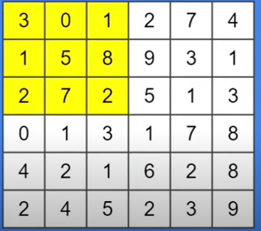

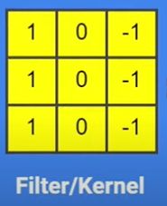
3 x 3
Filter: The small kernel (matrix) used to extract features from input data in a convolution.
If the filter is 3×33 \times 33×3, it looks at 3×33 \times 33×3 portions (patches) of the input matrix at a time.

Slide 13
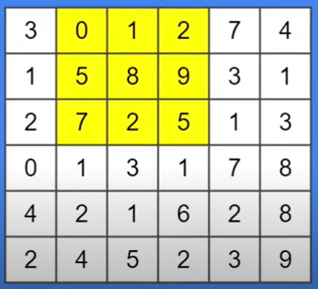
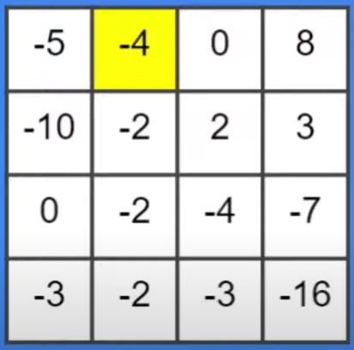
Stride: The step size the filter moves across the input (e.g., 1 for every pixel, 2 for every other pixel).

Slide 14
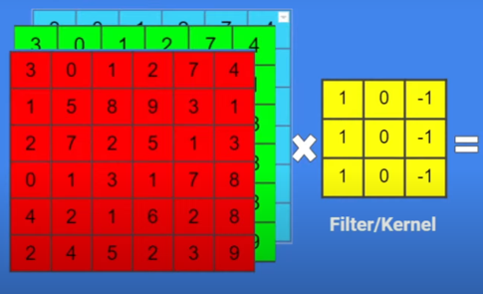
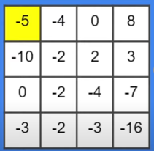
4 x 4
6 x 6

Slide 15
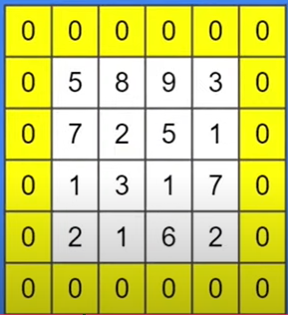
Padding: Adding extra pixels (usually zeros) around the input to control the output size.

Slide 16
MobileNet: A Deep Dive into Efficiency

Slide 17
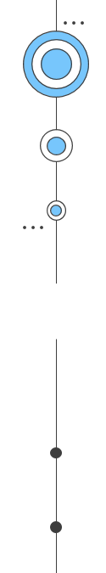
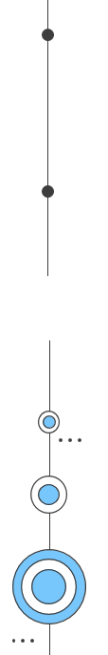
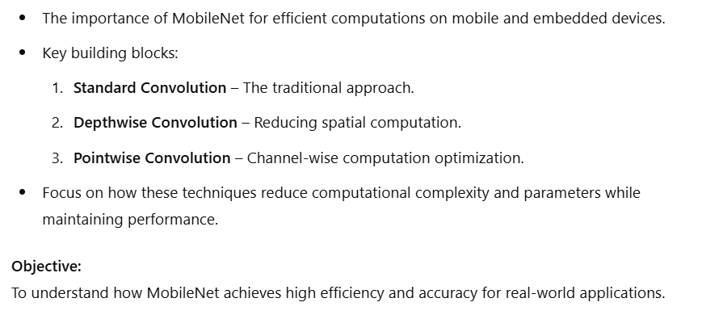
MobileNet: A Deep Dive into Efficiency

Slide 18
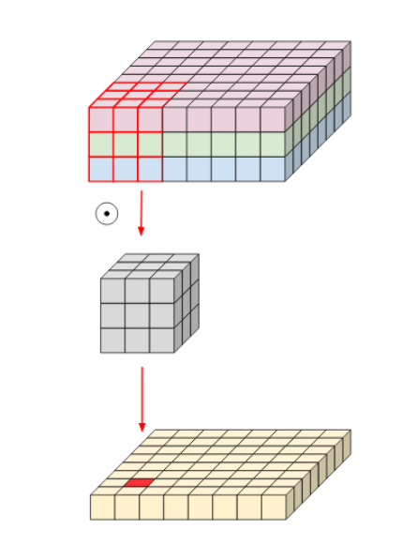
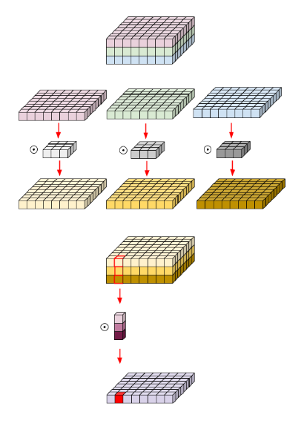
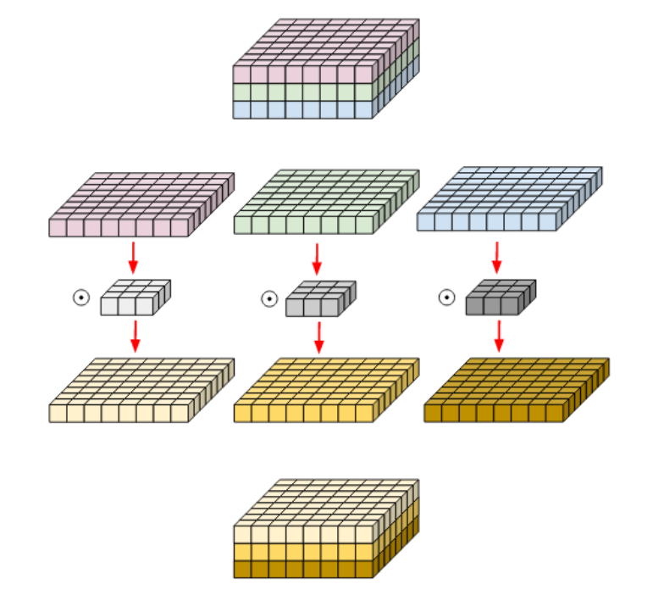
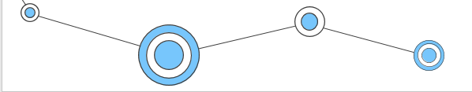
Standard Convolution
Pointwise Convolution
Depthwise Convolution

Slide 19
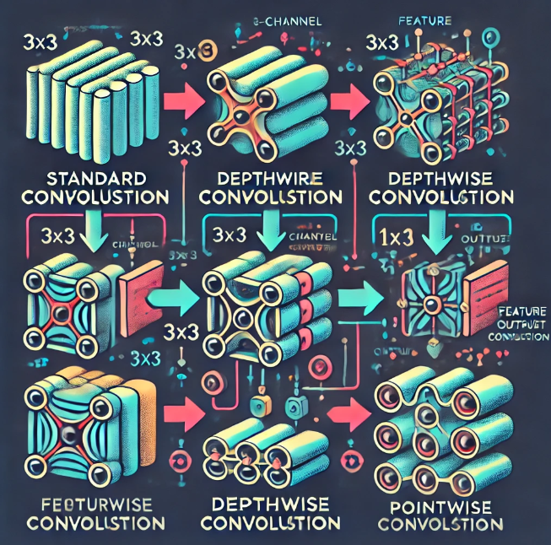
Standard Convolution:
Computationally heavy, combines spatial and channel info in one step.
Depthwise Convolution:
Applies spatial filtering to each channel separately.
Pointwise Convolution:
Combines depth information across channels.

Slide 20

MobileNet allows to operate on devices with limited computational power while maintaining reasonable accuracy

Slide 21
In MobileNet
standard convolution
computationally expensive
depthwise convolution & pointwise convolution
These two methods together reduce the number of parameters and computational complexity, making MobileNet more efficient while maintaining good performance for image classification tasks.

Slide 22
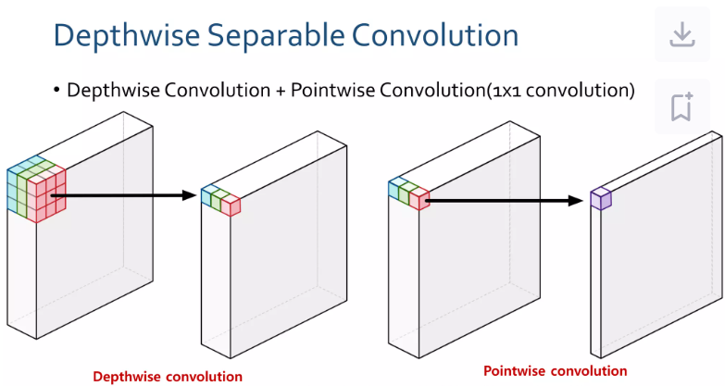

Slide 23
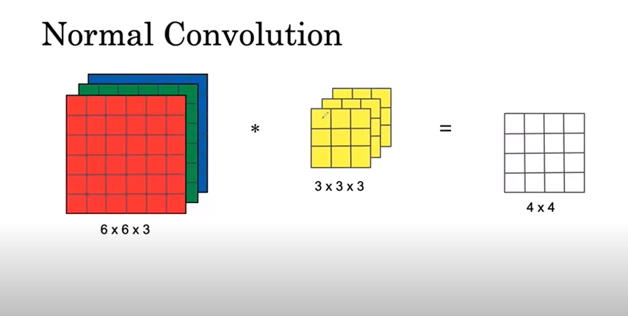
Filters
Output
Input

Slide 24
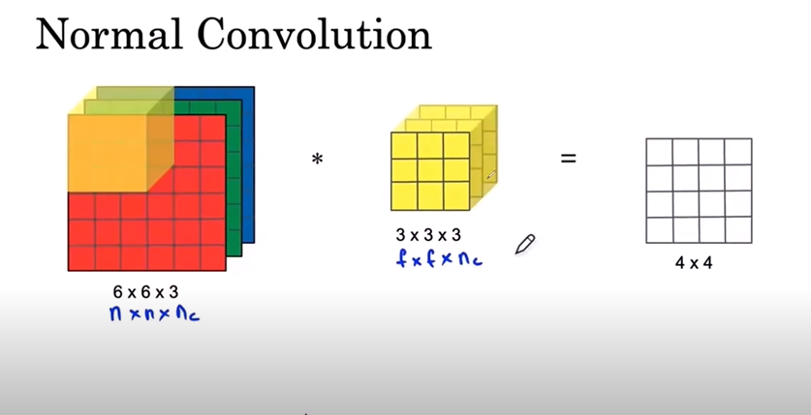
q
Number of Filters = 5 (you want 5 output channels).
Output:
Output size = 4 × 4 × 5
Width & height = 4 × 4
Channels = 5
Filters:
Size = 3 × 3 × 3:
Width & height = 3 × 3:
Channels = 3
Input: Size = 6 × 6 × 3
Width & Height = 6 × 6
Depth/Channels = 3

Slide 25
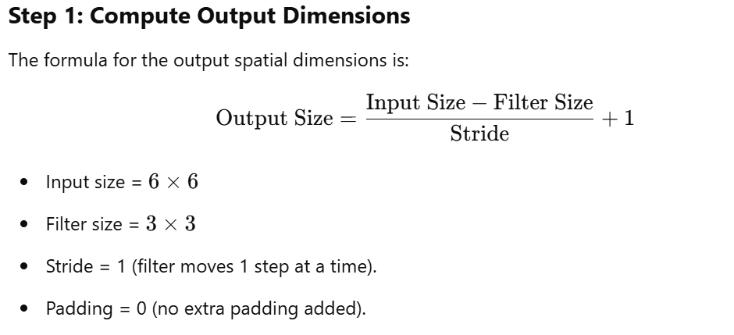
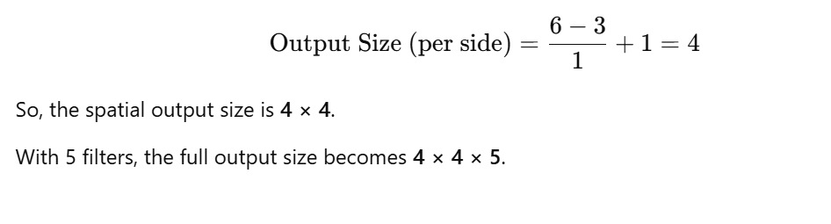

Slide 26
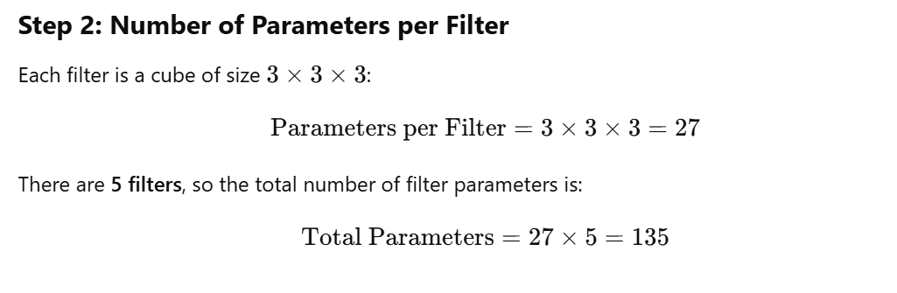
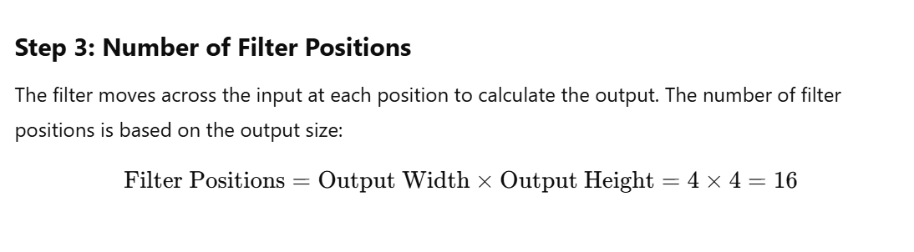

Slide 27
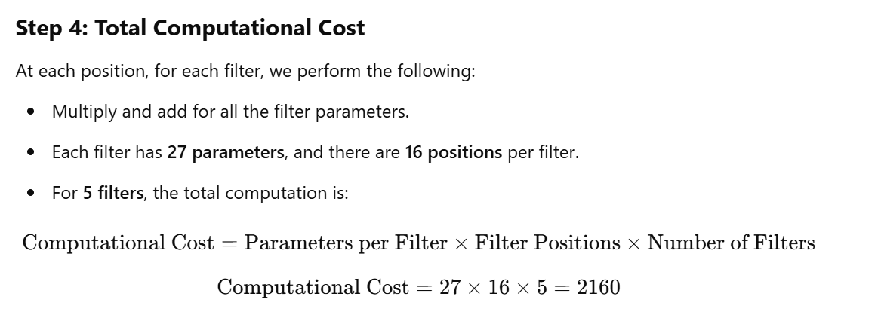

Slide 28
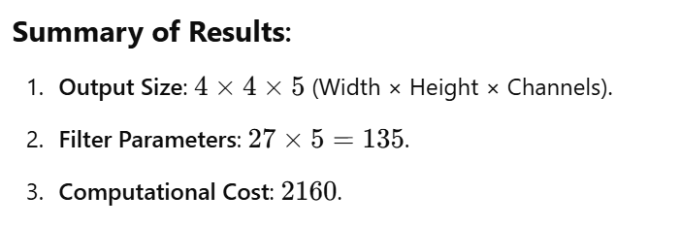

Slide 29
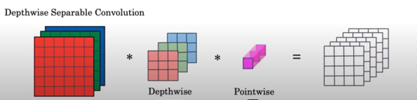

Slide 30
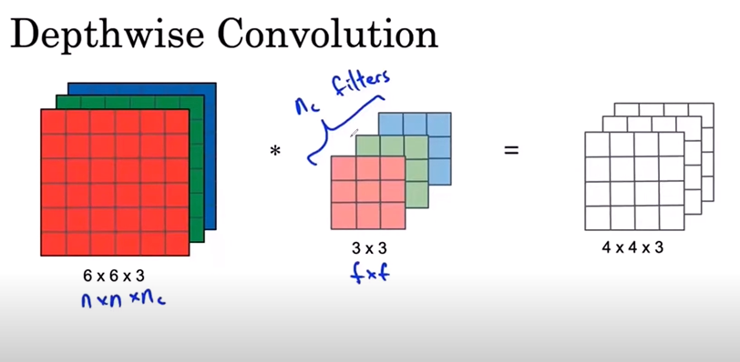
3
2
1
3
2
1
Filter 1 operates only on the red channel.
Filter 2 operates only on the green channel.
Filter 3 operates only on the blue channel.

Slide 31

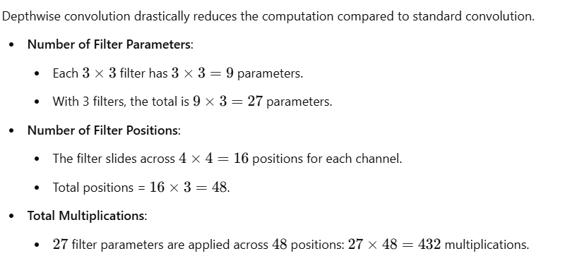

Slide 32
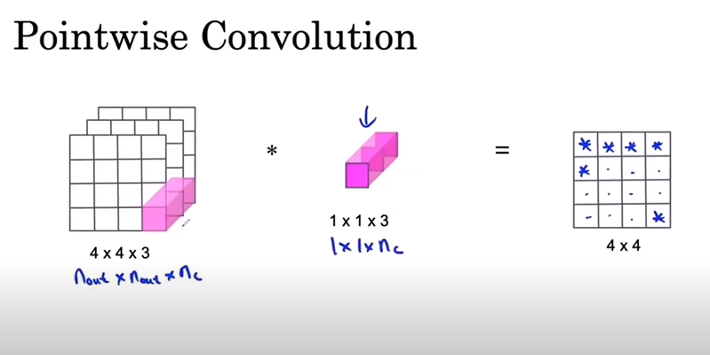

Slide 33
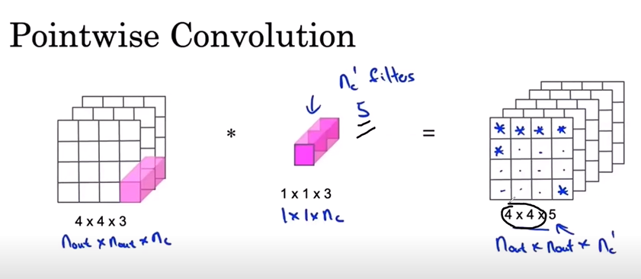
Input Tensor: 4×4×34
Filters: 5 filters, each of size
Output Tensor: After applying 5 filters, the output will have 4×4×5
Here, 5 (output channels) corresponds to the number of filters.

Slide 34
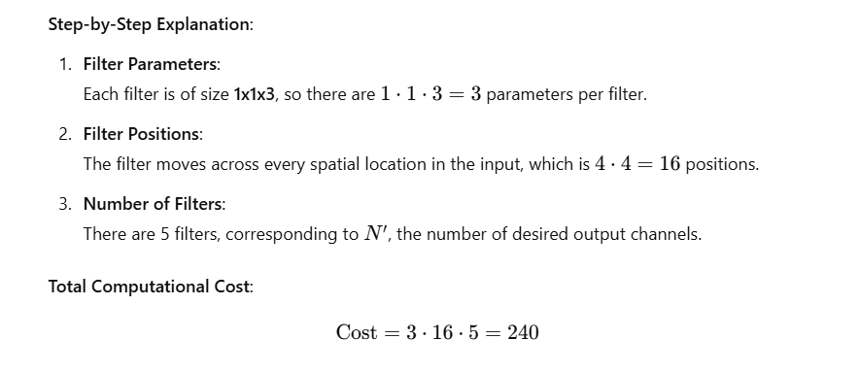

Slide 35
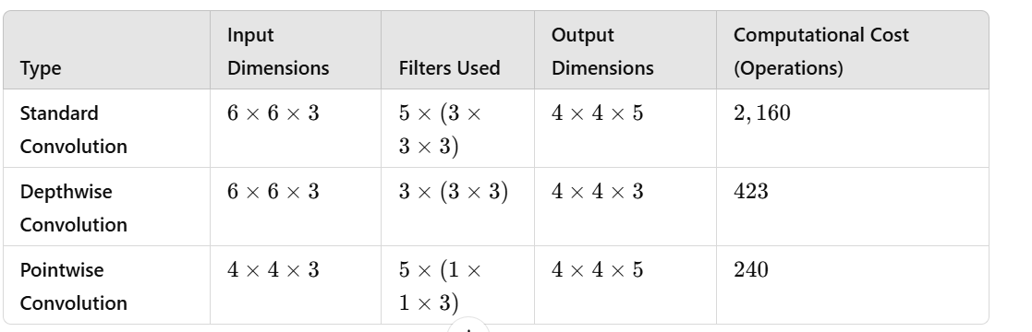
Comparison of computational costs

Slide 36
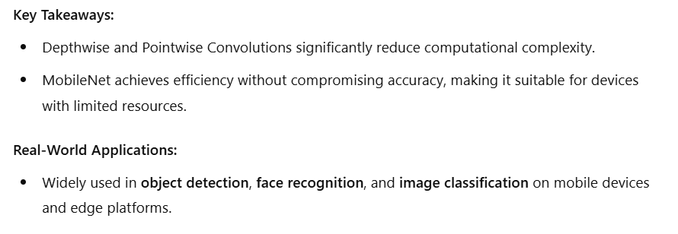


Slide 37
MobileNet v1 & MobileNet v2

Slide 38
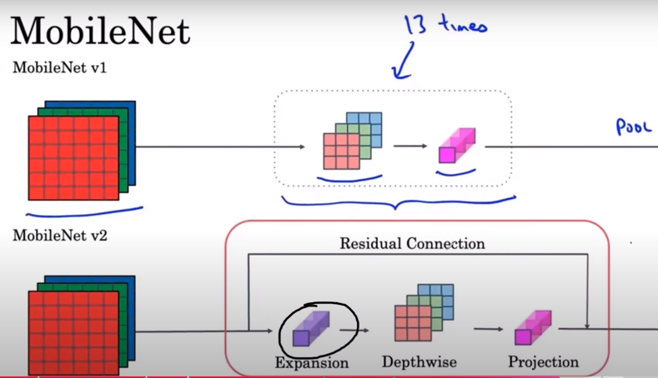

Slide 39
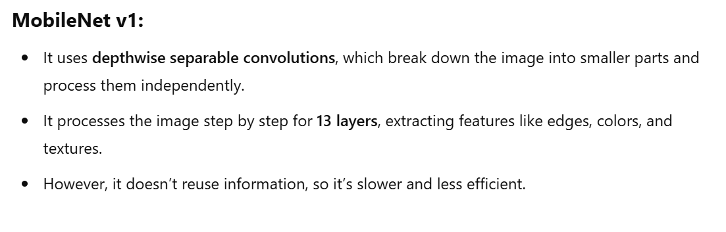

Slide 40
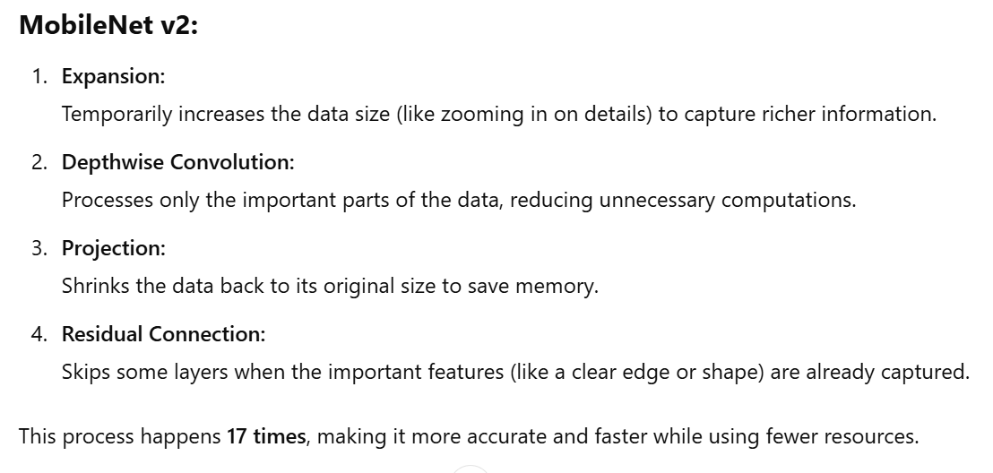
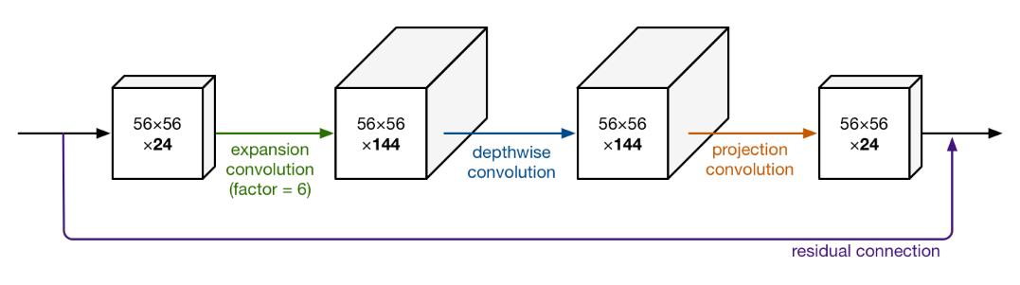

Slide 41
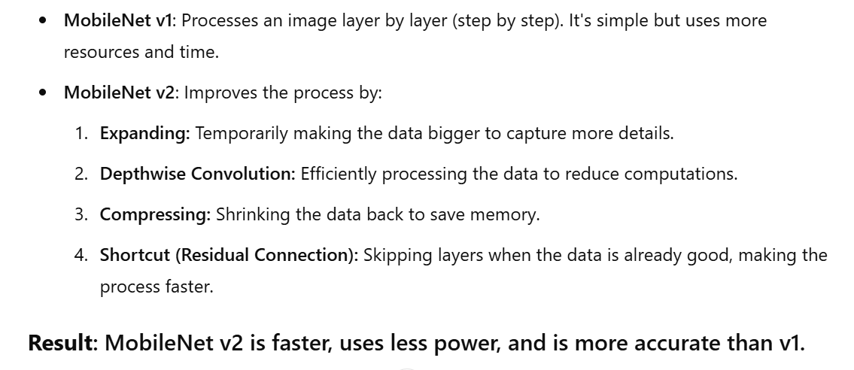

Slide 42
Classifier Example Using ReLU6 and Softmax

Slide 43
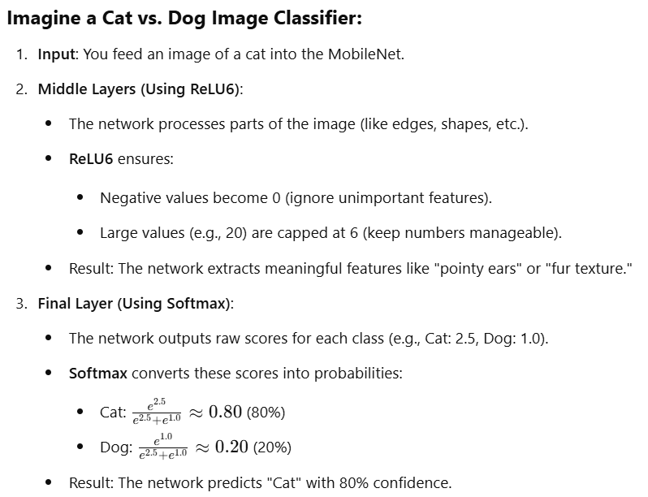
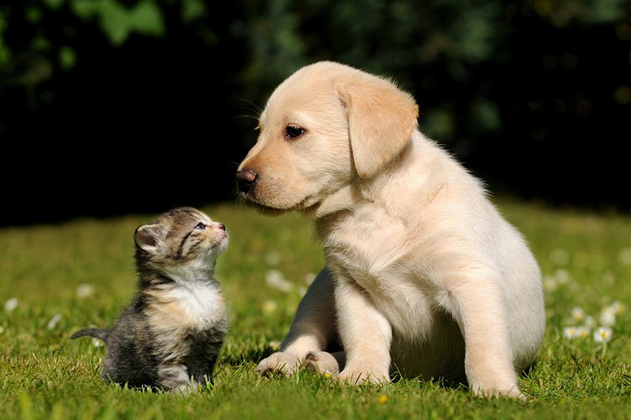

Slide 44
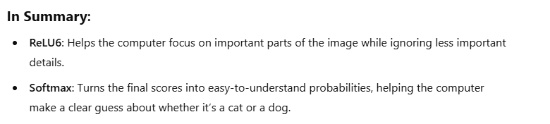
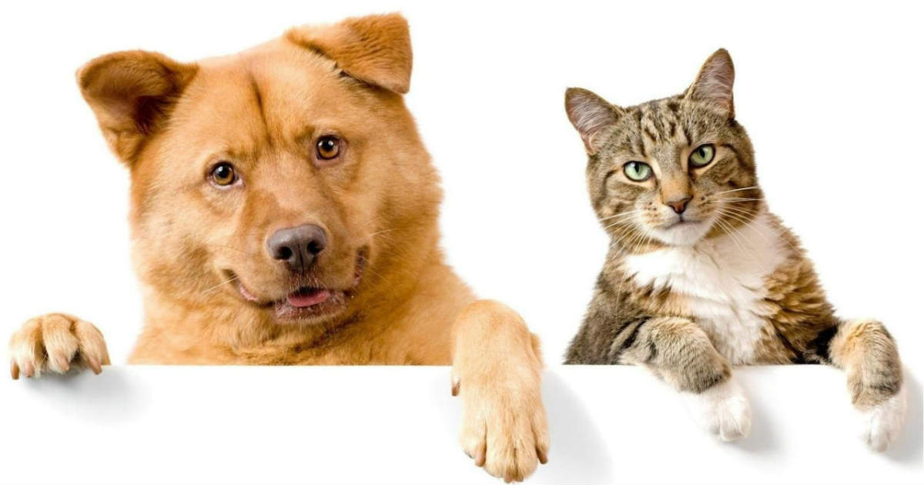

Slide 45
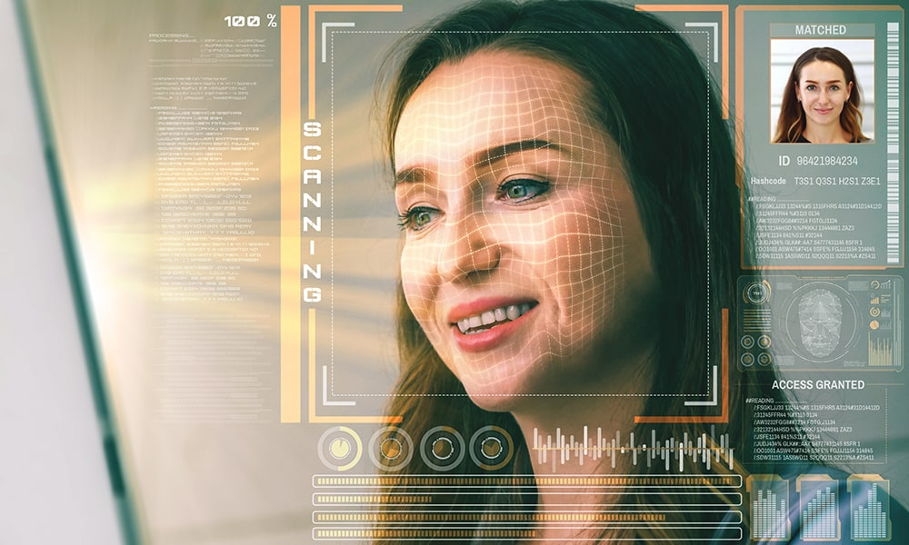
Image Classification
It is a task in computer vision, in which we categorize images into predefined classes using the MobileNet architecture, a lightweight and efficient Convolutional Neural Network (CNN) designed for mobile and resource-constrained devices.

Slide 46
Why MobileNet for Image classification?
MobileNet is specifically designed for efficient image classification, making it highly suitable for scenarios where computational resources are limited. Here’s why MobileNet is a preferred choice:
Lightweight and efficient architecture
Depthwise separable convolutions
Real-time performance on mobile devices
Scalable with width and resolution multipliers
Pretrained models for transfer learning
Low memory requirements
Cross-platform compatibility (e.g., TensorFlow Lite, PyTorch Mobile)
CNN in Image classification?
CNNs extract spatial features from images using convolution layers.
MobileNet uses depthwise separable convolutions:
Applies one filter per input channel (depthwise convolution).
Combines outputs with 1x1 convolutions (pointwise convolution).
Reduces computational cost and improves efficiency for mobile devices.

Slide 47
Algorithm

Slide 48
Step 1:
Import Libraries
tensorflow
MobileNet
preprocess_input
decode_predictions
Step 2:
Load the Pre-trained MobileNet Model:
model = MobileNet(weights='imagenet')
Step 3:
Define the image URL and download the image:
Fetch the image from the URL
Resize the image to 224x224 (required by MobileNet)

Slide 49
Step 4:
Preprocess the image for the model:
Convert the image to a NumPy array
Preprocess the image to match MobileNet’s input requirements
Add a batch dimension (as MobileNet expects batch input)
Step 5:
Run the image through the model to get predictions:
predictions = model.predict(image)
Step 6:
Decode the predictions to get human-readable class labels:
decoded_predictions = decode_predictions(predictions, top=1)
Step 7:
Display the result:
Print the predicted class label and confidence score

Slide 50
Collab Link
https://colab.research.google.com/drive/1I_F1Q49XzH1__xPCwY39yVwnAemegVLv?authuser=0
https://colab.research.google.com/drive/1jLMaOMjd58XoDY3rAGn7hvdLLiSmVnLy?authuser=0#scrollTo=u1g-efVuYrSX
https://colab.research.google.com/drive/1iCkX7XgLVp7KaLBgcGA3jMJJyTqeeC0y

Slide 51
REFERENCES
Sandler, M., Howard, A., Zhu, M., Zhmoginov, A., & Chen, L. (2018). MobileNetV2: Inverted residuals and linear bottlenecks. arXiv. https://arxiv.org/abs/1801.04381
Papers with Code. (n.d.). MobileNetV2: Inverted Residuals and Linear Bottlenecks. https://paperswithcode.com/method/mobilenetv2
YouTube. (2018, December 19). MobileNetV2 explained - Neural networks made simple. YouTube. https://www.youtube.com/watch?v=QFZjvj8xzH8
YouTube. (2020, March 16). MobileNetV2 explained - Neural networks made simple [Video]. YouTube. https://youtu.be/96q1wKG9Xcw?feature=shared

Slide 52
Thanks!
Do you have any questions?

